Slide 1
CS 2160 Appendix B
Basics of Logic Design

Slide 2
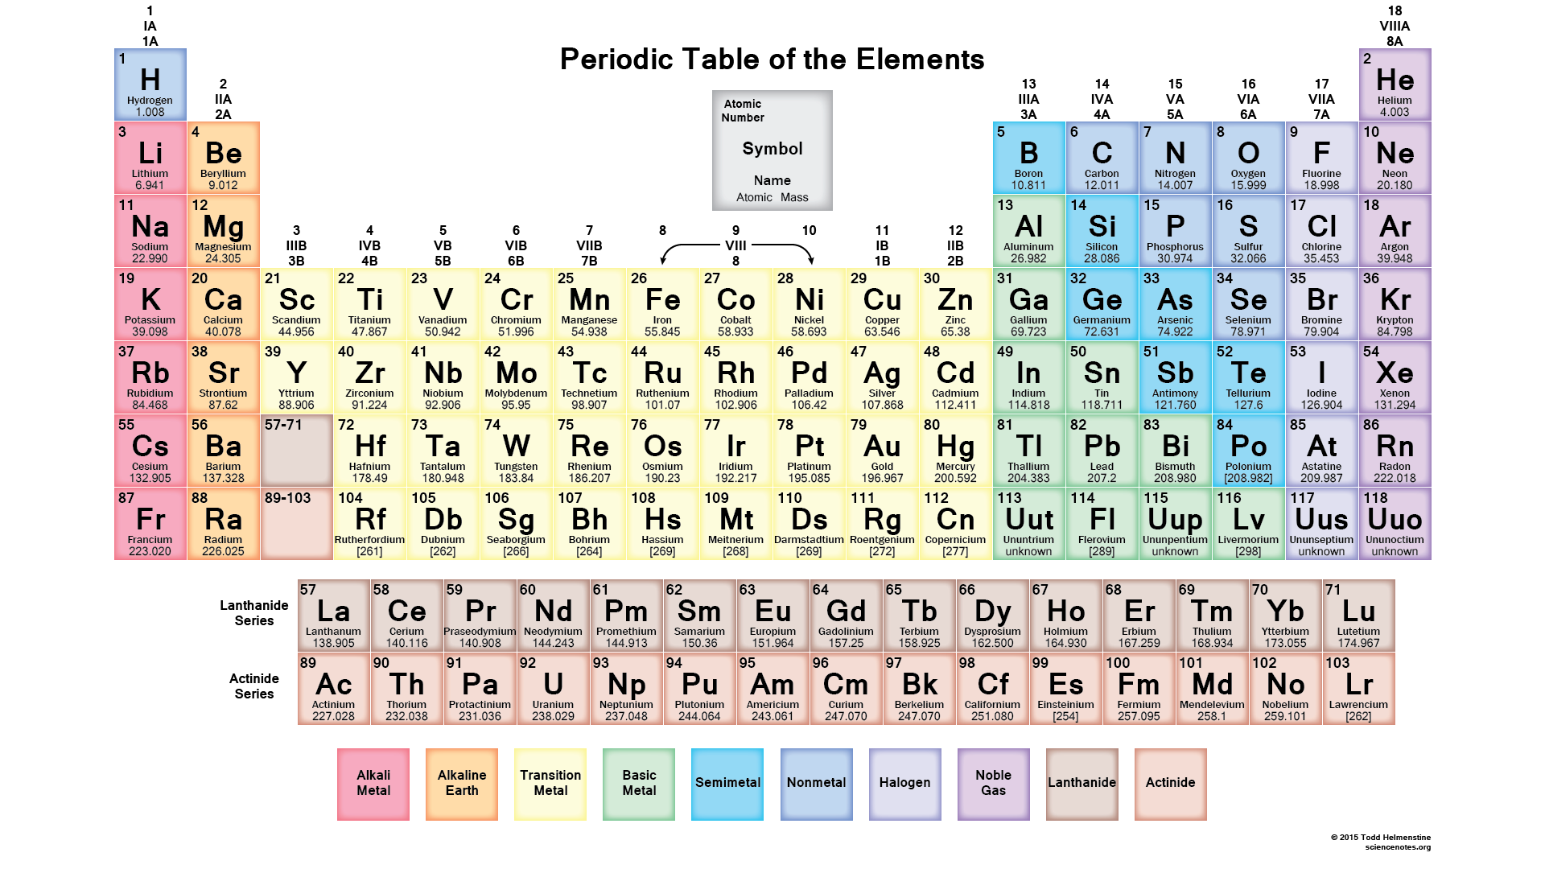
It all Begins with Silicon

Slide 3
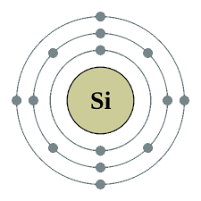
Why
Atomic number 14, halfway between Neon (10) and Argon (18)
Four electrons (of 8 spaces) in the outer (m) shell
Can gain or lose 4 electrons
Binds with four other Si atoms in a regular lattice
Image from Ritchie, Robert O. , “Failure i=of Silicon: Crack formation and Propagation”, 13th Workshop on Crystalline Solar Cell Materials and Processes August 2003, Vail, Colorado, p. 4.

Slide 4
Temperature Limitations
Top design temp for Intel Core i7 series is 100⁰C, many other processors are in the 90⁰-95⁰C range.
Max Equipment operating temperature is roughly 125⁰C.
Electron transfer failures occur around 140⁰C.
Depends on doping, spacing and voltage and current.
“Failure mechanism of semiconductor devices” retrieved from http://www.semicon.panasonic.co.jp/en/aboutus/pdf/ t04007be-3.pdf
“The Influence of Temperature on Microelectronic Device Failure Mechanisms”, SBIR Final Report, Sept 4, 1993., p 48.

Slide 5
Given all that, Let’s See What We Can Do
Philosophical comment on complexity
Physics of silicon used to be remarkable, but is now commonplace
Photoengraved transistors used to be cutting-edge, but now are everyday
Languages which once worked directly with hardware once were brand new
Compilers which performed better optimizations than humans were novel
Overall, computing structures are getting more complex with time
Similar to how life has evolved
Second law of thermodynamics works against this
Need more energy to stay organized
Catastrophic breakdowns if energy isn’t available

Slide 6
The Hierarchy of How Things Work
Operating Systems
High Level Languages
System Architecture
Instruction Set Architecture
Manufacturing and Production
Logic Design
You Are Here
Electrical Engineering of Digital Circuits
Construction of transistors and other components
Physics of silicon, copper and other materials
You Were Here

Slide 7
A Few Definitions
Gate: Simple circuit that produces an output from two inputs
Assertion: Logical 1, usually a voltage above a certain level
Deassertion: Logical 0, usually a voltage below a certain level
Logic Block: Group of gates which assemble inputs and produce outputs
Combinational Logic: Logic block whose outputs are purely a product of its inputs at a moment in time
Sequential or Stateful Logic: Logic block with memory whose outputs are a product of current and past inputs
B-4

Slide 8
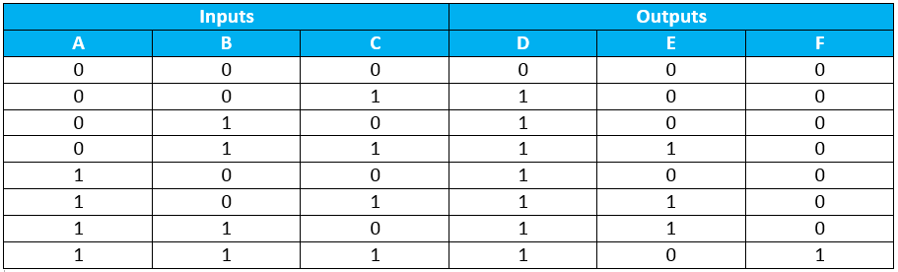
Truth Tables
2³ Entries
Truth tables often have 2^{n} entries, but may be reduced if some signals are “don’t care”s or if outputs are not unique
B-5

Slide 9
Sums of Products
A way of reducing truth tables
Looking at output D in the table, write a logic statement for each row of inputs where the output is a 1
Yes, the answer is intuitive, but let’s do it longhand to see that it works.

Slide 10
Solve for D
!A && !B && C ||
!A && B && !C || !A &&&B && C ||
A && !B && !C || A && !B && C ||
A && B && !C || A && B && C
= !A && !B && C ||
!A && B && (C || !C) ||
A && !B && (C || !C) ||
A && B && (C || !C) ||
= !A && !B && C || !A && B || A && !B || A && B
= !A && !B && C || !A && B || A &&(!B || B)
= !A && !B && C || !A && B || A
= !A && (B || !B && C) || A
= A || (B || !B && C)
= A || B || C

Slide 11
Solve for E and F
E
!A && B && C || A && !B && C || A && B && !C
=!A && B && C || A && (!B && C || B && !C)
=!A && B && C || A && (B xor C)
F
A && B && C

Slide 12
Boolean Logic
Operations
OR (+)
AND (*)
NOT (-)
Basic Laws
B-6

Slide 13
Representations
Traditional
C
E = ((A & B) | (A & C) | (B & C)) & !(A & B & C)
Or
E = ((A && B) || (A && C) || (B && C)) & !(A && B && C)
Verilog
Similar to C with some variations because it is a process description
Blocking (result not available until next cycle)
Non-Blocking (result available immediately)
B-7

Slide 14
Gates: AND, OR and NOT
B-8

Slide 15
From Truth Table to Circuits
D = A || B || C
A
B
C
D
E = !A && B && C || A && !B && C || A && B && !C
A B C
F = A && B && C
A
B
C
F
E

Slide 16
Decoders
B-9

Slide 17
Multiplexor Implementation
A multiplexor selects one of a number of inputs
Constructed from Gates
What we see in CPU circuits
B-10

Slide 18
Programmable Logic Arrays
All logic can be done by ORs, ANDs and NOTs.
Circuits can invert inputs and outputs if necessary
That leaves ANDs and ORs for the “middle” of the circuit
Two basic constructs
Sum of products
A = (A * B) + (C * D)
Product of sums
A = (A + B) * (C + D)
Can use this to go from a truth table to a circuit design
B-12

Slide 19
PLA’s (continued)
AND plane (products)
Minterms
OR plane
Sum of products
B-13

Slide 20
PLA Implementation
Inputs A, B and C; Outputs D, E, and F.
D is true if at least one input is true.
E is true if exactly two inputs are true.
F is true only if all three inputs are true.
Truth table at right, circuit below:
AND plane
OR plane
B-15

Slide 21
Alternate PLA Representation
Minterms
B-16

Slide 22
Read-Only Memories
A kind of logic device
Multiple inputs, multiple outputs plus a mapping
PLA contains a pattern of how to produce outputs from inputs
ROM contains explicit specification of outputs which correspond to inputs
ROM more flexible, but doesn’t scale as well with increasing number of inputs.
B-16

Slide 23
Truth Table in ROM
Address | Contents
0 | 0
1 | 4
2 | 4
3 | 6
4 | 4
5 | 6
6 | 6
7 | 5

Slide 24
Don’t Cares
Inputs
Input is unused or inconsequential
Outputs
Output is not used
B-18

Slide 25
MIPS Instructions
MIPS instructions have 6-bit Operations Codes and those with OpCode = 0 have 6-bit Function Codes.
Bits are Op0 – Op5 and Fct0 – Fct5
R-type
I-type
J-type
Bit 0 on the right, bit 31 on the left
These codes are interpreted by the processor to execute the instructions
The execution path depends on multiplexor settings
Op
Rs
Rt
Rd
Shamt
Fct
Op
Rs
Rt
Imm
Op
Imm

Slide 26
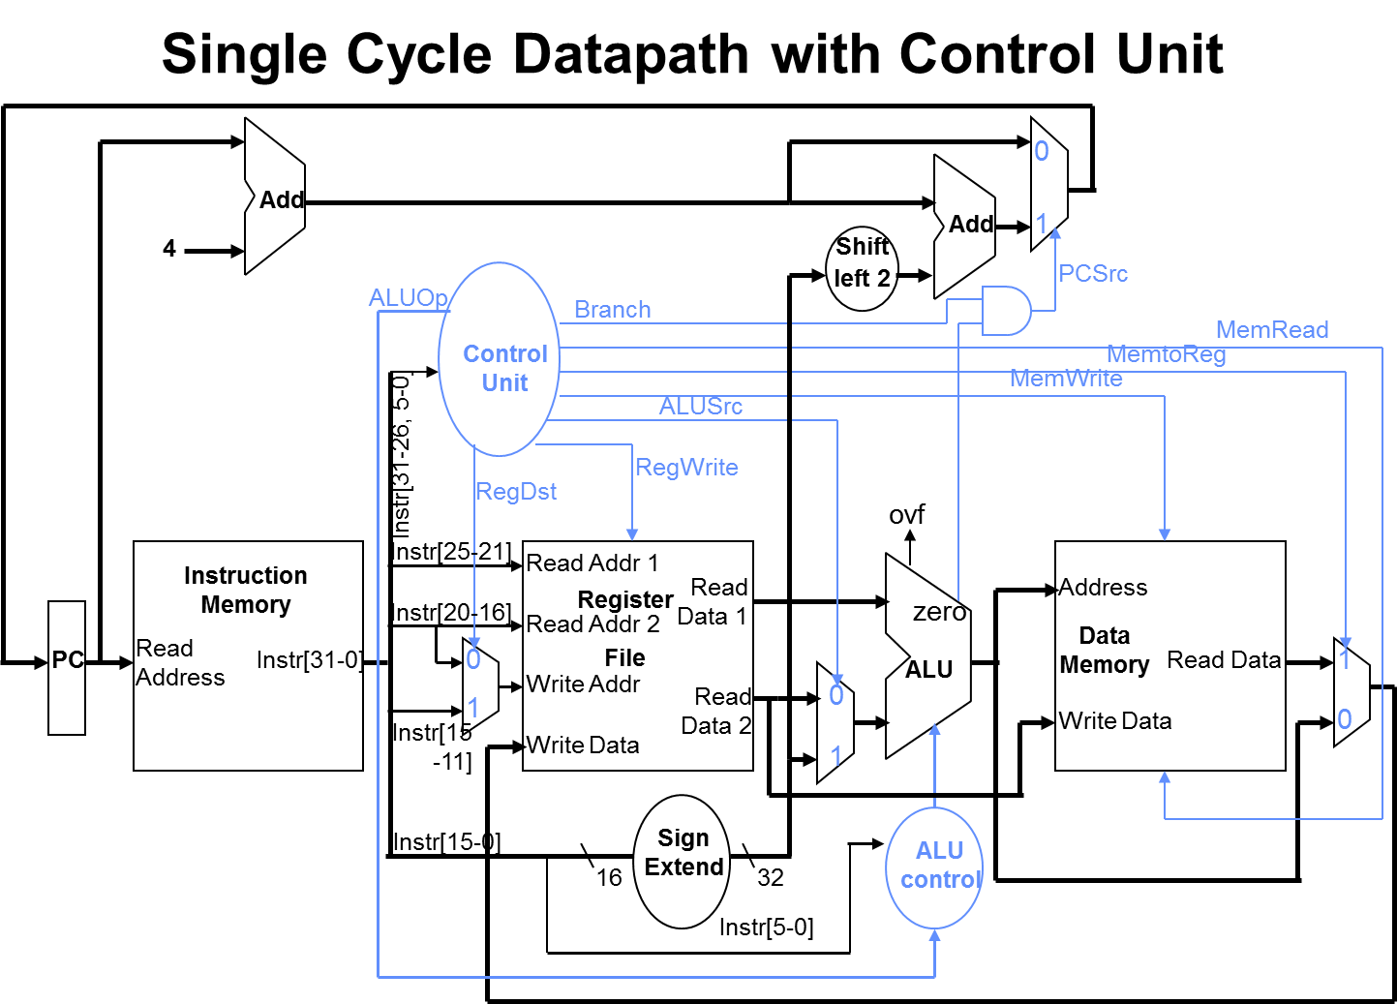
CPU Control Overview
RegDst determines whether Rd or Rt is the destination register

Slide 27
Determining RegDst
Inst | Op 0-5 | Op5 | Op4 | Op3 | Op2 | Op1 | Op0 | Fct 0-5 | Reg Dst
Add | 0x00 | 0 | 0 | 0 | 0 | 0 | 0 | 0x20 | 0
Addi | 0x08 | 0 | 0 | 1 | 0 | 0 | 0 | Xx | 1
addiu | 0x09 | 0 | 0 | 1 | 0 | 0 | 1 | Xx | 1
Addu | 0x00 | 0 | 0 | 0 | 0 | 0 | 0 | 0x21 | 0
beq | 0x04 | 0 | 0 | 0 | 1 | 0 | 0 | Xx | 0
lw | 0x23 | 1 | 0 | 0 | 0 | 1 | 1 | xx | 0
sub | 0x00 | 0 | 0 | 0 | 0 | 0 | 0 | 0x22 | 0
subu | 0x00 | 0 | 0 | 0 | 0 | 0 | 0 | 0x23 | 0
sw | 0x2b | 1 | 0 | 1 | 0 | 1 | 1 | Xx | 0
RegDst = !Op5 && !Op4 && Op3 && !Op2 && !Op1

Slide 28
Busses
B-19

Slide 29
Example: Parity Logic
Even Parity: even number of 1’s.
Which column (a, B, C, D) represents even parity output?
Possible outputs
Possible inputs from 4 bits
Can be implemented in a read-only memory, or as an add with no carry
B-20

Slide 30
Hardware Description Language
Behavioral specification
Describes how a digital system operates functionally.
Structural specification
Describes how a digital system is organized in terms of a hierarchical connection of elements.
Hardware synthesis tools
Computer-aided design software that can generate a gate-level design based on behavioral descriptions of a digital system.
Languages
Verilog
VHDL
B-21

Slide 31
Regs and Wires
In Verilog, regs and wires are basic building-blocks
reg[31:0] X
wire [31:0] Y
An array of registers (as in MIPS register file)
reg[31:0] registerfile [31:0]
i.e., 32 32-bit registers
B-22

Slide 32
Assignment Statements
Blocking assignment
Value is available next clock cycle
Symbol is <=
Non-blocking assignment
Value is available immediately
Symbol is =
B-25

Slide 33
Which are Blocking / Non-blocking Devices?
 | Sign Extender | Register File | ALU | Shift-Left 2
Blocking
Non-Blocking
X
X
X
X

Slide 34
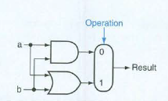
And/Or Unit
A unit that can do ands and ors on command actually does both all the time and the result is selected based on the desired operation.
B-27

Slide 35
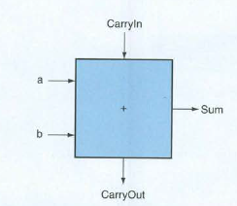
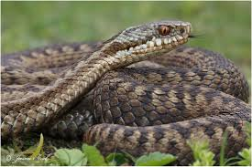
One-bit adder
B-27

Slide 36
Adder Truth Table

Slide 37
Negative numbers
Invert the bits (invert the data bits)
Add 1 (set carry-in to 1)
Five in a binary byte: 0000 0101
Invert the bits: 1111 1010
Add 1: 1111 1011 (that’s -5)
How do we know?
Add the two, get 0

Slide 38

Subtraction producing a negative result
Negative result
Remember, farthest bit on the left is 1 if negative
B-30

Slide 39
Why Two’s Complement?
It works the simplest in circuits
Same logic as addition
But, it implies knowledge about whether the 32 bits represent signed or unsigned numbers

Slide 40
Arithmetic Logic Unit
Increasingly complex circuits
AND / OR device
Adder plus AND / OR
Add / Subtract plus AND and OR
All that plus integer multiply and divide
First designed for one bit, then ganged together x 32
B-33

Slide 41
32-bit ALU
Used for SLT
B-34

Slide 42
The MIPS ALU
B-37

Slide 43
MIPS ALU in Verilog
The control signal tells the ALU what to do. This has timing implications.

Slide 44
Things happening in parallel
Software is sequential, inherently not parallel
Hardware can be constructed to be truly parallel
So by adding more hardware, operations can happen more quickly
But sometimes complexity expands exponentially
B-39

Slide 45
Speeding up Carry
The original design was “ripple carry”
Can use some logic to determine the carry result quickly, but it takes several ors and ands
Basically doing what the adder does to calculate a carry, but skipping the logic for the result.
Thus, at the expense of hardware, carries can be calculated faster than ripple speed.
B-39

Slide 46
Infinite Carry
Pretend we can have as much hardware as we’d ever want—what would we do?
This provides two bounding limits
How big (costly) could the hardware possibly be
How fast could it possibly be?
Since we almost always have to balance performance vs design and cost, this gives us a way to perform quantitative tradeoffs.
B-39

Slide 47
Finding the Balance
Carryin2 =(b1·Carryin1)+(a1· Carryin1) + (a1· b1)
This is the basic equation. If we apply it to two successive bits, we have
c2 = (b1·cl)+(a1·cl)+(a1·b1)
cl = (bO·cO)+(aO·cO)+(aO·bO)
Substituting for c1 in the top equation we get
c2=(a1·aO·bO)+(a1·aO·cO)·(a1·bO·cO)+(b1·aO·bO)+(b1·aO·cO)+(b1·bO·cO)+(a1·b1)
In the above equation, we can find common terms and reduce its size
gi=ai·bi
pi=ai+bi
Now we can write out the carries for four bits
c1=gO+(pO·cO)
c2=g1+(p1·gO)+(p1·pO·cO)
c3=g2+(p2·g1)+(p2·p1·gO)+(p2·p1·pO·cO)
c4=g3+(p3·g2)+(p3·p2·g1)+(p3·p2·p1·gO)+(p3·p2·p1·pO·cO)
Turns out that eight groups of four speed up 32-bit ripple carry by a factor of four with an acceptable amount of hardware.
B-40

Slide 48
Schematically
Four carry calculators operating on four bits at once. Need two of these for a 32-bit ALU.
B-45

Slide 49
Performance Improvement
Knowing the and/or gate layout, assume 1 unit of time per and or or in series
Count the gate time for a ripple carry adder
Count the gate time for a 8 x 4-bit carry
Gate time improvement turns out to be roughly a factor of six
B-46

Slide 50
Clocks
Rising edge: read state
Falling edge: write state
B-49

Slide 51
Register File Schematic

Slide 52
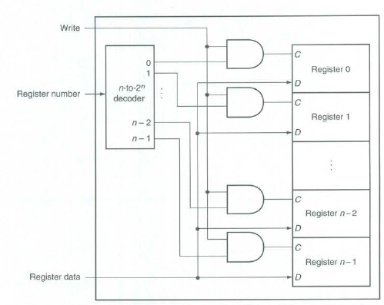
Writing to the Register File
Writes to all registers are possible. The decoder selects the write that matches what the instruction calls for
B-56

Slide 53
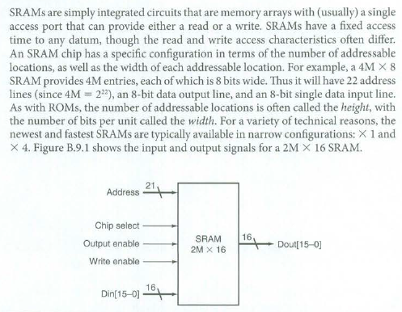
An important thing about memory
Sample Product
B-58

Slide 54
Finite State Machines
Used to implement logic on chips
Moore machine: state change just depends on current state
Traffic light cycles green-yellow-red- green-yellow-red
Mealy machine: state change depends on current state and an input
Traffic light which responds to presence of cars
(Compare to Combinational / Sequential Logic)
Combinational: inputs only
Sequential: inputs plus state
B-67

Slide 55
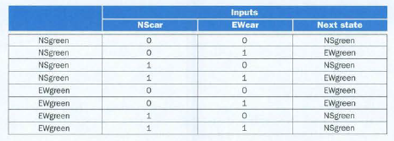
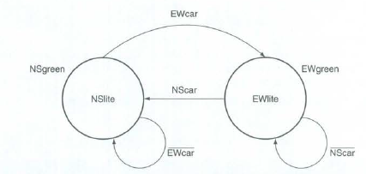
FSM Representations
Table
Graph
B-69

Slide 56
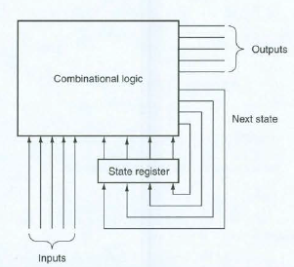
FSM Implementation
Available on a clock cycle
Updated on a clock cycle
Available on a clock cycle
B-71

Slide 57
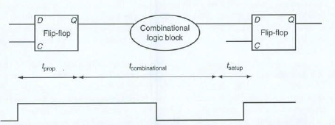
Clocks
T_{prop}: time for signal to propagate through flip-flop (clock-to-Q)
T_{comb}: time for combinational results to stabilize
T_{setup}: time flip-flop input must be available before clock edge
Rising edges determine when “snapshot” state is sampled
Must allow time for setup to occur
Tcycle >= T_{prop}+ T_{comb} + T_{setup}
B-73

Slide 58
Clock Skew
Different in arrival time of clock pulse at different components
Can be caused by capacitive coupling
Can be caused by path length
Clock cycle time must account for skew so that variations in pulse arrival do not affect values read from devices
B-74

Slide 59
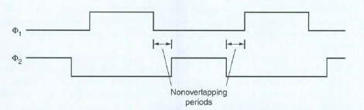
Two-Phase Clocking
Two synchronized clock waveforms
Can better control timing of complex logic
Fewer race conditions
More sensitive to skew
B-75

Slide 60


Asynchronous vs Synchronous
Asynchronous: timing not involved
Synchronous: bits mean things depending on clock cycle
Synchronous output = Asynchronous input & Clock
Synchronizer—works across two clock cycles
B-77

Slide 61
Programmable Devices
Programmable Logic device
Combinational logic only
Field Programmable Gate Array
Includes memory
Sequential logic
Favorite for MIPS prototyping
Involves permanent fusing (or unfusing) of connections inside the FPGA
B-78

